Slide 1
2D Arrays and Lists
Mack 2023
Notes:
Last updated: 09-12-20
Resources are updated regularly — the latest version is available at: ncce.io/tcc.
This resource is licensed under the Open Government Licence, version 3. For more information on this licence, see ncce.io/ogl.

Slide 2
Make a prediction
Starter activity
1 2 3 4 | scores = [["Fred", "Wilma", "Dino"], [4, 5, 6]] print(scores[0])
Questions .
Do you notice anything new about the structure of the scores list?
What do you think the output will be when this program is executed?

Slide 3

Make a prediction
Starter activity
1 2 3 4 | scores = [["Fred", "Wilma", "Dino"], [4, 5, 6]] print(scores[0])
The scores list holds more than one list.
This is known as a two-dimensional list.
Notice the extra square brackets [] that surround each list and then the usual square brackets surrounding the entire structure.
A 2D list is a list of lists.

Slide 4
Make a prediction
Starter activity
1 2 3 4 | scores = [["Fred", "Wilma", "Dino"], [4, 5, 6]] print(scores[0])
scores[0] will access the list at position 0 which is why all of the items in that list have been displayed.
You will explore this further during the lesson.
['Fred', 'Ginger', 'Dino'] >>>

Slide 5

2D arrays and list
Objectives
In this lesson, you will:
Define a 2D array and a list
Use a 2D list in a program

Slide 6
What is a two-dimensional list?
Activity 1
A list is used to hold multiple elements under one name.
A two-dimensional list allows you to hold a list as one element.
Data in a 2D list can be held in rows and columns.

Slide 7
What is a two-dimensional list?
Activity 1
A 2D list can be used to hold the player names and scores for a game.
Row 0 holds the player names.
 | 0 | 1 | 2
0 | Fred | Wilma | Dino
1 | 4 | 5 | 6
Row 1 holds the player scores.

Slide 8
What is a two-dimensional list?
Activity 1
Each column then holds the data for each player.
A 2D list can be used to hold the player names and scores for a game.
 | 0 | 1 | 2
0 | Fred | Wilma | Dino
1 | 4 | 5 | 6

Slide 9
What is a two-dimensional list?
Activity 1
A 2D list can be used to hold the player names and scores for a game.
 | 0 | 1 | 2
0 | Fred | Wilma | Dino
1 | 4 | 5 | 6
Each new row is a new list.

Slide 10
What is a two-dimensional list?
Activity 1
A 2D list can be used to hold the player names and scores for a game.
 | 0 | 1 | 2
0 | Fred | Wilma | Dino
1 | 4 | 5 | 6
2 | 3 | 3 | 4
If a new row is needed, then you add another list.

Slide 11
Index locations
Activity 1
1 2 3 4 | scores = [["Fred", "Wilma", "Dino"], [4, 5, 6]] print(scores[0])
You can access each list in the 2D list in the same way that you access a single element in a list.

Slide 12
Index locations
Activity 1
1 2 3 4 | scores = [["Fred", "Wilma", "Dino"], [4, 5, 6]] print(scores[0])
Accesses the list at location 0

Slide 13
Index locations
Activity 1
1 2 3 4 | scores = [["Fred", "Wilma", "Dino"], [4, 5, 6]] print(scores[1])
Accesses the list at location 1

Slide 14
Index locations
Activity 1
1 2 3 4 | scores = [["Fred", "Wilma", "Dino"], [4, 5, 6]] print(scores[0][0])
To access a single item in a single list, you need an extra bit of code.

Slide 15
Index locations
Activity 1
1 2 3 4 | scores = [["Fred", "Wilma", "Dino"], [4, 5, 6]] print(scores[0][0])
To access a single item in a single list, you need an extra bit of code.
Row
index
Column
index

Slide 16
Index locations
Activity 1
1 2 3 4 | scores = [["Fred", "Wilma", "Dino"], [4, 5, 6]] print(scores[0][0])
To access a single item in a single list, you need an extra bit of code.
Question .
What will be the output of this program when it is executed?
Row
index
Column
index

Slide 17
Index locations
Activity 1
1 2 3 4 | scores = [["Fred", "Wilma", "Dino"], [4, 5, 6]] print(scores[0][0])
To access a single item in a single list, you need an extra bit of code.
Question .
What will be the output of this program when it is executed?
Fred
Row
index
Column
index

Slide 18
Index locations
Activity 1
1 2 3 4 | scores = [["Fred", "Wilma", "Dino"], [4, 5, 6]] print(scores[0][0])
The first value is the list or row that you wish to access.
Row
index

Slide 19
Index locations
Activity 1
1 2 3 4 | scores = [["Fred", "Wilma", "Dino"], [4, 5, 6]] print(scores[0][0])
The second value is the index of the item in that list.
Column
index

Slide 20
Index locations
Activity 1
1 2 3 4 | scores = [["Fred", "Wilma", "Dino"], [4, 5, 6]] print(scores[1][2])
Question .
What will be the output of this program when it is executed?
Row
index
Column
index

Slide 21
Index locations
Activity 1
1 2 3 4 | scores = [["Fred", "Wilma", "Dino"], [4, 5, 6]] print(scores[1][2])
Question .
What will be the output of this program when it is executed?
6
Row
index
Column
index

Slide 22
Index locations
Activity 1
1 2 3 4 | scores = [["Fred", "Wilma", "Dino"], [4, 5, 6]] print(scores[0][1])
Question .
What will be the output of this program when it is executed?
Row
index
Column
index

Slide 23
Index locations
Activity 1
1 2 3 4 | scores = [["Fred", "Wilma", "Dino"], [4, 5, 6]] print(scores[0][1])
Question .
What will be the output of this program when it is executed?
Wilma
Row
index
Column
index

Slide 24
2D arrays and 2D lists
Activity 1
The same rules apply to 2D arrays and lists as single arrays and lists.
A 2D array must be a predefined fixed size and each item held must be of the same data type.
A 2D list can vary in size throughout program execution and contain multiple data types.

Slide 25
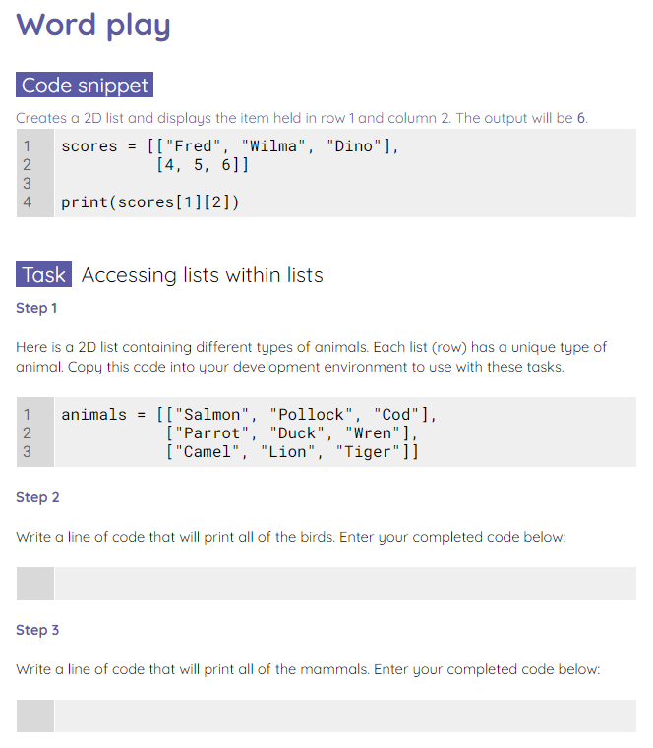
Word play
Activity 1
Use the worksheet to practise navigating a 2D list.

Slide 26
Changing items in a 2D list
Activity 2
1 2 3 | words = ["Dog", "Fish", "Cat"] words[0] = "Cow"
To replace an item in a one-dimensional list, you need to specify the location and provide the value that you wish to replace it with, in this case, cow.
Assign cow at location 0

Slide 27
Changing items in a 2D list
Activity 2
1 2 3 4 5 | animals = [["Salmon", "Pollock", "Cod"], ["Parrot", "Duck", "Wren"], ["Camel", "Lion", "Tiger"]] animals[0][2] = "Plaice"
You can do the same thing with a 2D list, you just need to specify the location of the item.
Replace item in row 0 at index location 2 with Plaice.

Slide 28
Appending a 2D list
Activity 2
1 2 3 | words = ["Dog", "Fish", "Cat"] words.append("Cow")
If you want to append (add to) a 1D list, then you state the name of the list and use .append() to add the new item.
Add cow to the words list.

Slide 29
Appending a 2D list
Activity 2
1 2 3 4 5 6 7 | animals = [["Salmon", "Pollock", "Cod"], ["Parrot", "Duck", "Wren"], ["Camel", "Lion", "Tiger"]] animals.append("Trout") print(animals)
If you use exactly the same code with a 2D list, then it will just add another element to the end list structure.
[['Salmon', 'Pollock', 'Cod'], ['Parrot', 'Duck', 'Wren'], ['Camel', 'Lion', 'Tiger'], 'Trout'] >>>

Slide 30
Appending a 2D list
Activity 2
1 2 3 4 5 6 7 | animals = [["Salmon", "Pollock", "Cod"], ["Parrot", "Duck", "Wren"], ["Camel", "Lion", "Tiger"]] animals[0].append("Trout") print(animals)
If you want to append a specific list within the 2D list, then you specify which list.
[['Salmon', 'Pollock', 'Cod', 'Trout'], ['Parrot', 'Duck', 'Wren'], ['Camel', 'Lion', 'Tiger']] >>>

Slide 31
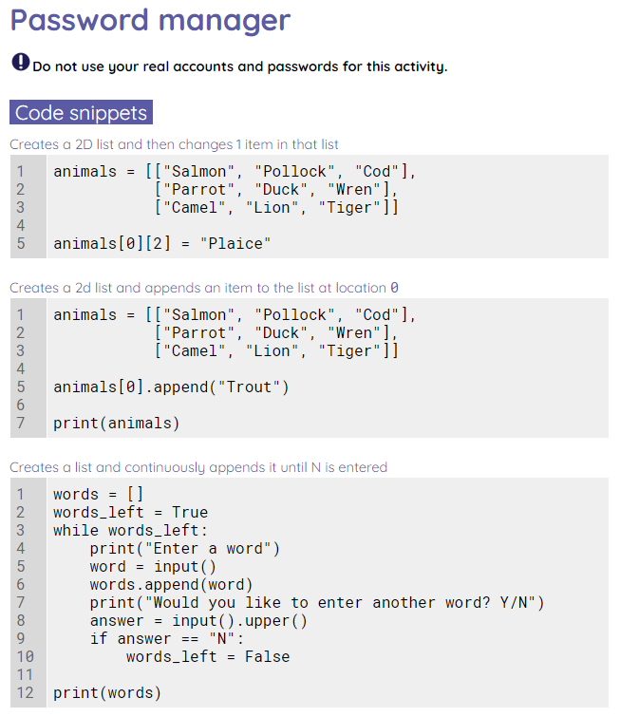

Password manager
Activity 2
Use the worksheet to create a password manager.
Do not use your real accounts and passwords for this activity.

Slide 32
Make a prediction
Wrap Up
1 2 3 4 5 6 7 8 9 10 | scores = [["Jim", "Bob", "Jenny"], [4, 5, 6]] print("Who's score do you need?") answer = input() location = scores[0].index(answer) score = scores[1][location] print(f"{answer}'s score is {score}")
Questions .
If Jenny is the input, what will be the output when this program is executed?
{answer}'s score is {score}
6
Jenny’s score is 6
Error: index out of range
1
2
▹
3
4

Slide 33
Next lesson
Summary
In this lesson, you…
Learnt about 2D lists and how to change and append items in them
Next lesson, you will…
Complete a mini project that uses 2D lists

